Slide 1

Team – DevOps Daemons
December 2018
TCS Confidential

Slide 2
Problem Statement:
Number of DDBank.com users have increased by 17% in last 8 months. This has increased the load on system and frequent down-times; thereby delayed responses to 8% user interactions. Since the automated monitoring and tuning is not present in the system, MTTR has also increased.

Slide 3

User Stories:
As a Ops SME,
I want to receive periodic reports
on application usage,
so that I can see trends over time.
As a Ops SME/member,
I need a tool,
so that I can continuously monitor
all the applications at once
in a single window.
As a Ops member,
I want to maintain configurations steps
in only one location,
so that the risk of
configuration divergence is reduced.
As a developer,
I need feedback from operations
about my application's impact
on Ops environment ,
so I can improve its behavior over time.
As a Ops SME,
I want to be notified when
applications crash
or are consuming too many resources
in a production environment,
so that recovery time can be reduced.
As a developer,
I need a way to perform
very small changes quicky,
so that I can deploy it in lesser time.

Slide 4
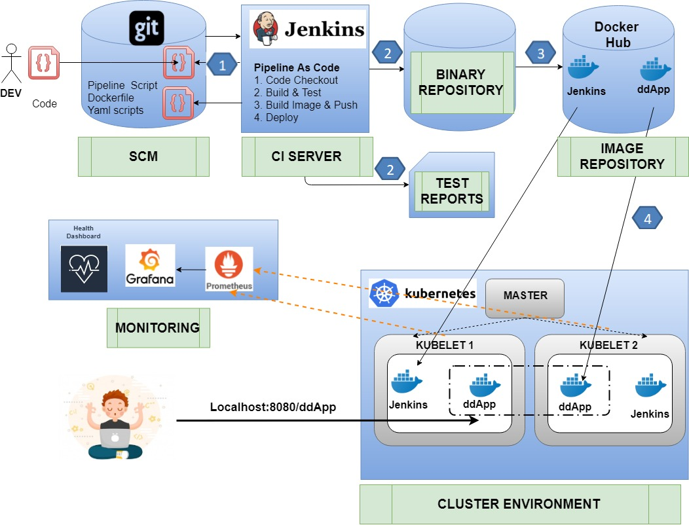

Slide 5
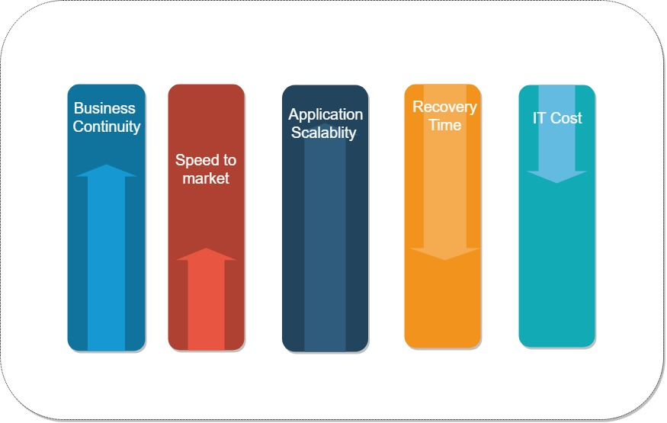
Business Benefits:

